Slide 1

Data Analysis on Churn Modelling
Parth Shah
NUID: - 002956963
Introduction to Analytics (ALY 6000)
Guided by: Prof. Mohammad Shafiqul Islam

Slide 2
Index
Introduction
Important Observation
Summary
Reference

Slide 3
Introduction
• For this project, we want to accomplish the following:
1.Determine and display the elements that cause client churn.
2.Create a prediction model that includes the following features:
Determine whether a customer is likely to churn.
Choose a model that will assign a likelihood to churn to make it easier for customer service to target low hanging fruit in their attempts to prevent churn, preferably based on model performance.

Slide 4
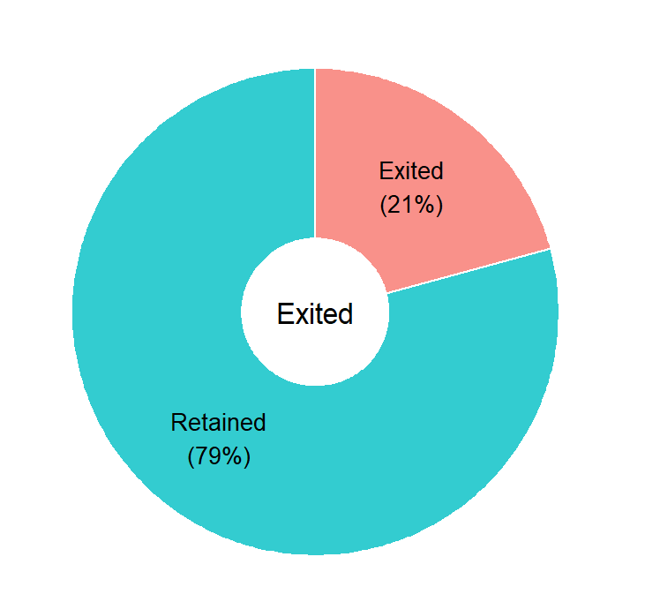
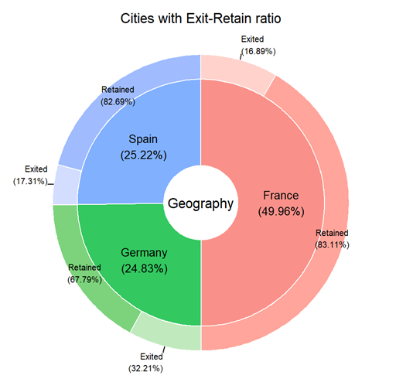
Image 1: - Exited Pie Chart
The overall snapshot of the dataset shows that 79 percent of consumers are retained, and 21 percent are exited.
Image 2:- Cities with Exit-Retain ratio
The dataset includes three cities, with over half of the data coming from France and the other half from Spain and Germany. Departed customer percent in France and Spain is 17 percent, whereas exited customer percent in Germany is 32 percent.

Slide 5
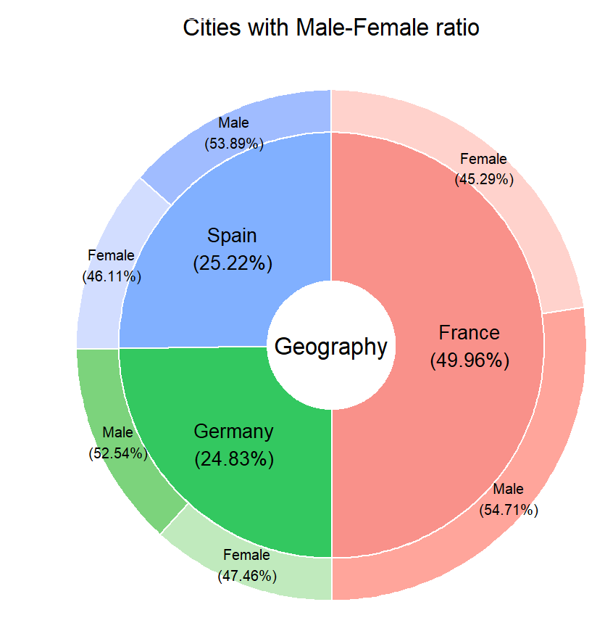
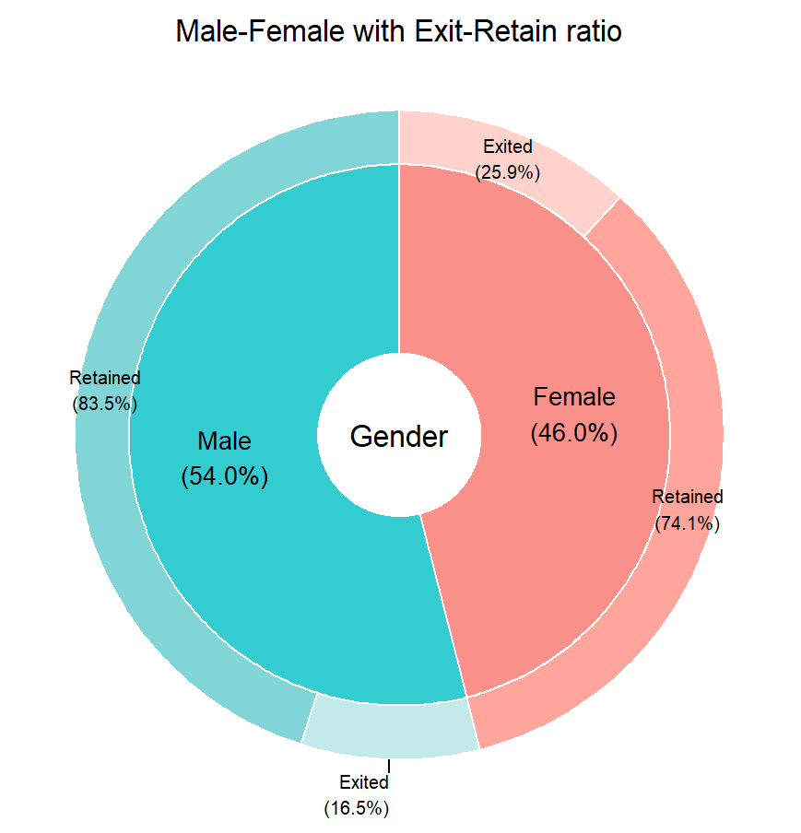
Image3: - Cities with Male-Female ratio
Females constitute 47 percent of the population in three cities, while males constitute 53 percent.
Image4: - Male-Female with Exit-Retain ratio
There are 54% males and 46% females, majority males were retained with 83.5% and for females 25% were exited.

Slide 6
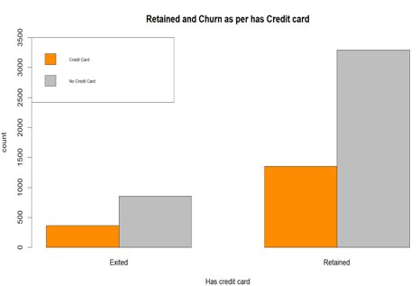
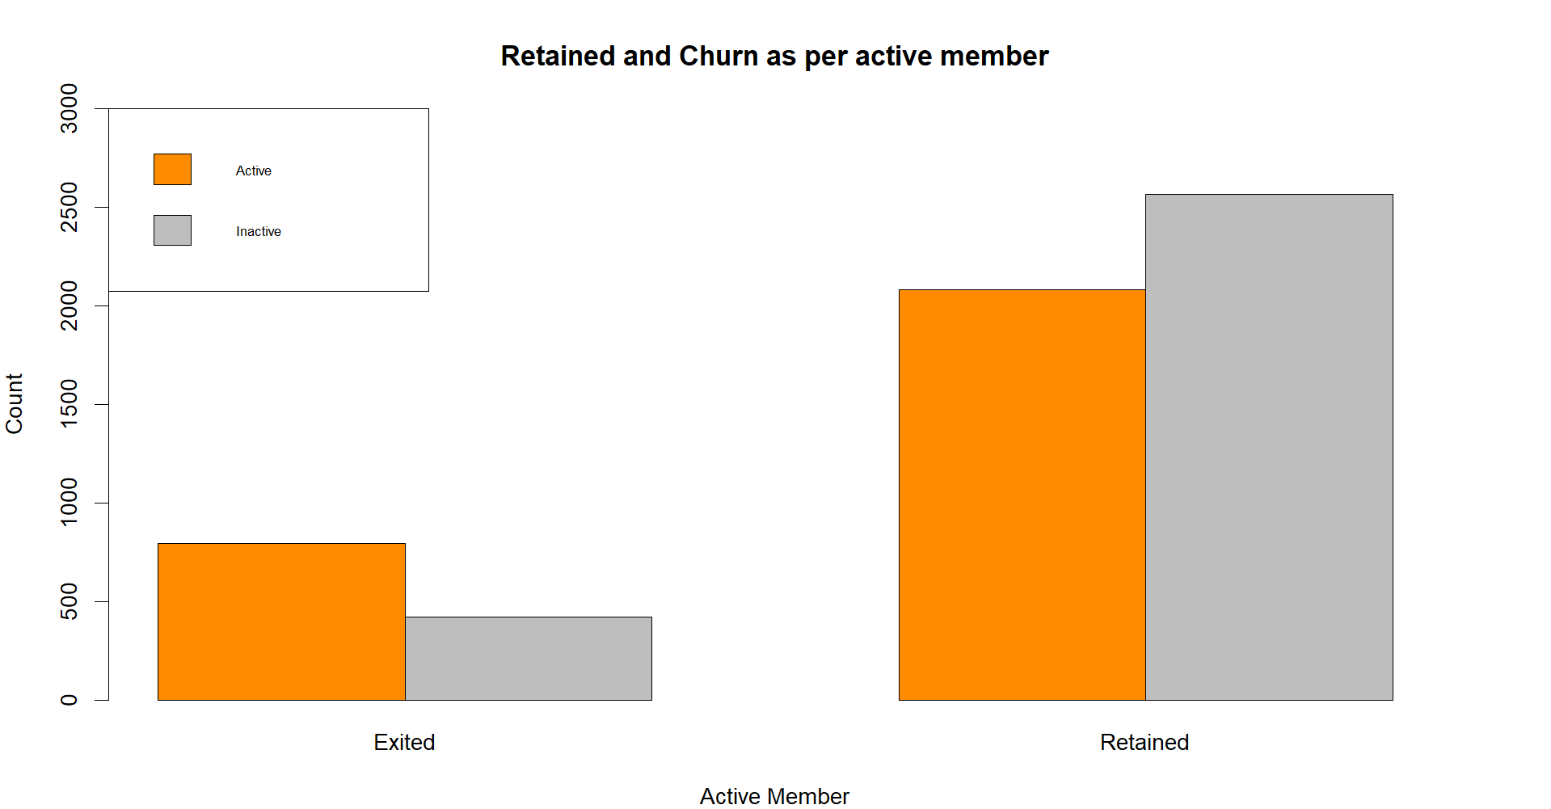
Image5: - Retained and Churn as per has Credit card
Consumers who did not have credit cards were retained the most, while customers who did have credit cards were evacuated the least.
Image6: - Retained and Churn as per active member
Inactive customers retained more than active customers, although active customers were more exited than non-active customers .

Slide 7
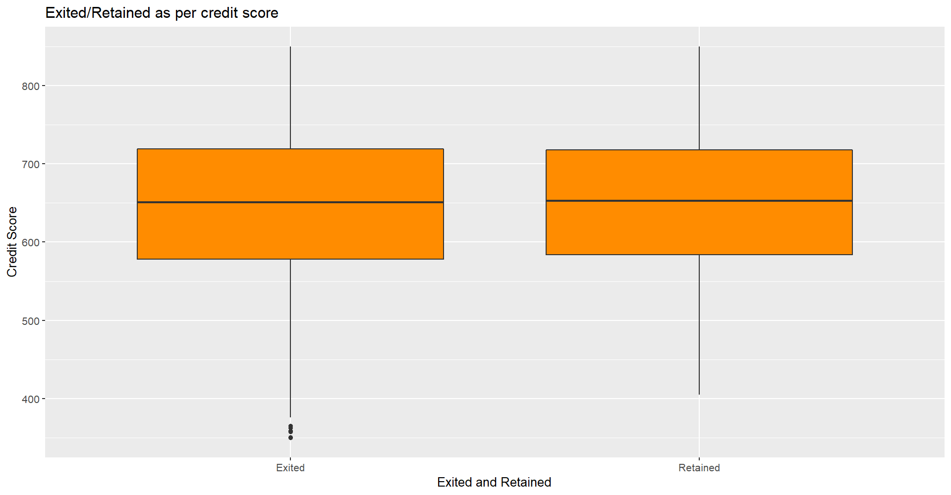
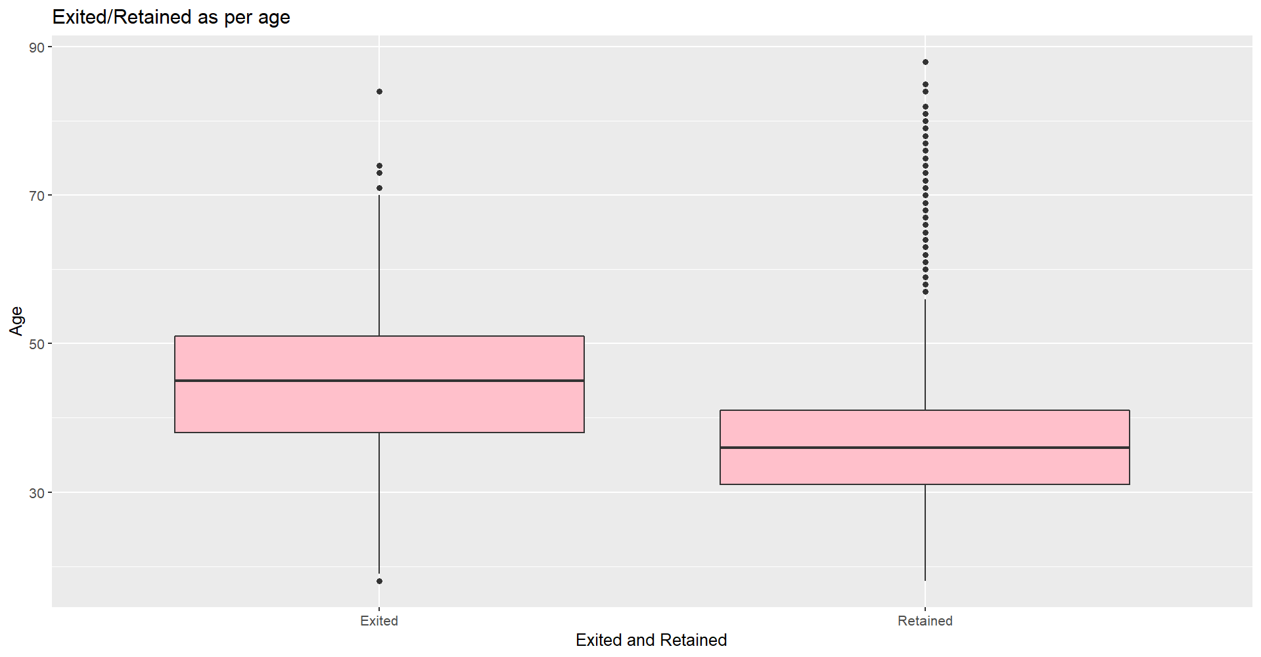
Image7: - exited/Retained as per age
Customers of a higher age group were more likely to leave, whilst younger ones were more likely to stay.
Image8: - Exited/Retained as per credit score
Customers were exited and retained in this boxplot based on credit scores that were almost identical, i.e., near 650.

Slide 8
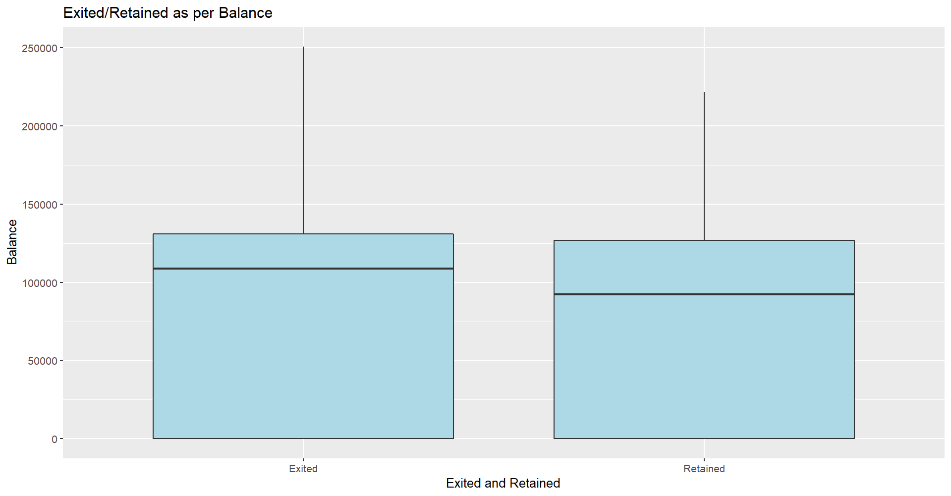
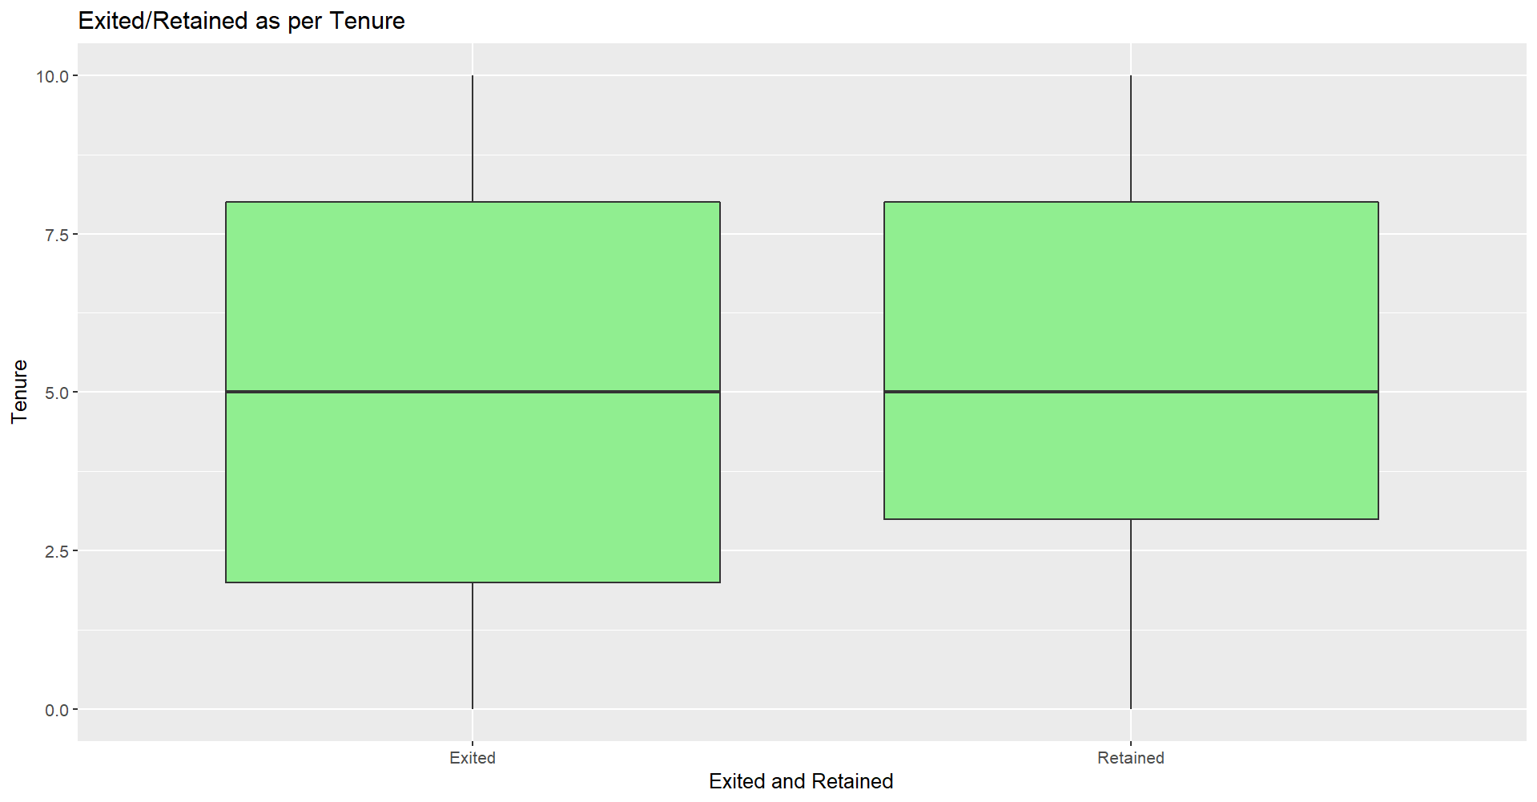
Image9:- exited/Retained as per Balance
Customers with a high balance were exited at a higher rate than those with a low balance.
Image10: - exited/Retained as per Tenure
Customers with a long stay were kept longer than those with a short duration, and the average is nearly indistinguishable.

Slide 9
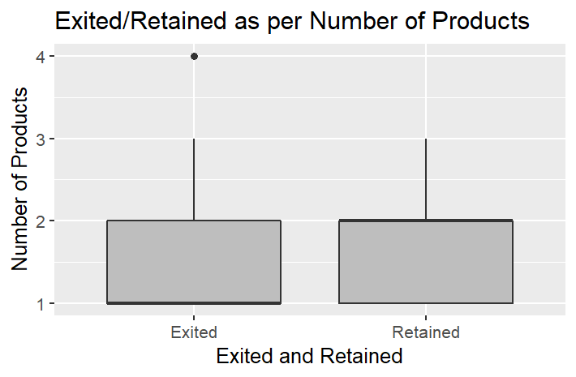
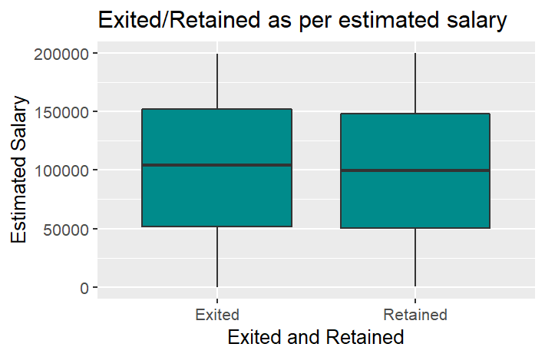
Image11: - exited/Retained as per Number of Products
Exiting customers account for one product on average, whereas retained customers account for two.
Image12: - Exited/Retained as per estimated salary
In terms of estimated compensation, the averages of those who were kept and those who were let go are nearly identical.

Slide 10
Summary
Consumers are kept in 79 percent of cases, whereas 21 percent leave. In France and Spain, 17 percent of customers have left, and in Germany, 32 percent of customers have left.
In three cities, females account for 47% of the population, while males account for 53%. Males account for 54 percent of the population, while females account for 46 percent.
Males account for 83.5 percent of the population, while females account for 25% of the population.

Slide 11
Reference
Kumar, S. (n.d.). Churn Modelling. Churn Modelling | Kaggle. https://www.kaggle.com/shubh0799/churn-modelling.
R CHARTS | A Collection Of Charts And Graphs Made With the R Programming Language. (n.d.). R CHARTS. https://r-charts.com/.

Slide 12

Thank You.

